Slide 1
Automated PII Identification and Redaction
Federal financial Build-A-thon 2024
Team – 6 – Freddie Mac and Fannie Mae

Slide 2
Agenda
Solution Overview
Architecture
Demo
FAQ

Slide 3
Overview
Develop a solution to redact Personally Identifiable Information (PII)
Enable fine-grained access control permissions on the data
Apply Business Intelligence to create reports and dashboards

Slide 4
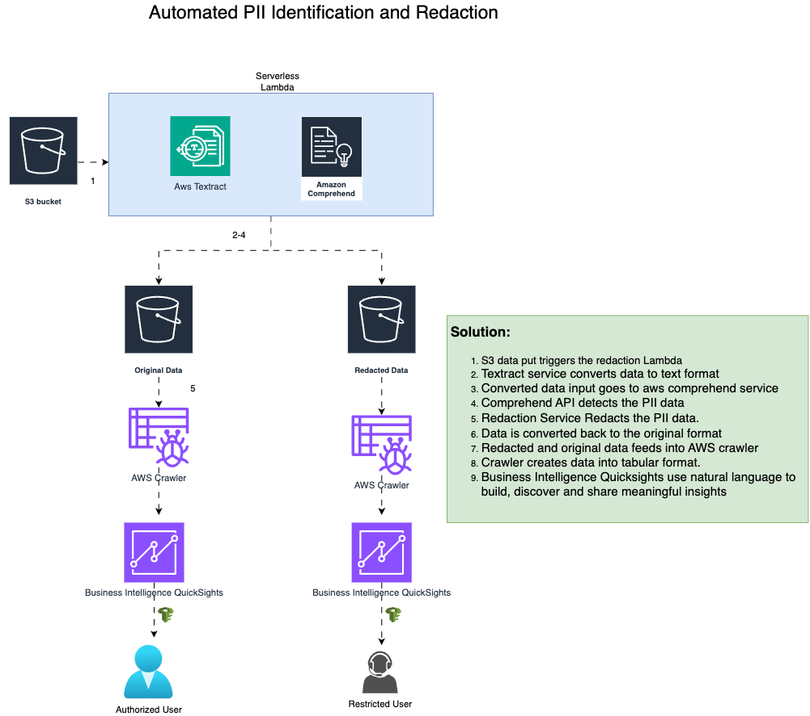
Workflow

Slide 5

Demo

Slide 6
Challenges
Service Selection – There are multiple options in AWS
Use of pillow library – Layer compatibility
Figure out textract API to filter out relevant data – Account ID’s
AWS Crawler and QuickSight integration

Slide 7
Githen Paul and Fannie Mae Guy
NishitTank and Pardeep Chahal
Ramu Chandu and Walter
Chahal.cse@gmail.com

